Slide 1

PyCaret: Automation for the Data Scientist
Your Name: Tejas Kulkarni
Course: OIM 7502 - Advanced Programming
https://github.com/tejas371-ai/OIM_7502_classwork.git

Slide 2
What is PyCaret? (The Library)
Definition: An open-source, low-code Python library that automates the entire ML workflow.
The Power: PyCaret is a wrapper around established libraries (scikit-learn, XGBoost, LightGBM, CatBoost). It packages complex functions into one line of code.
Key Advantage: It can replace hundreds of lines of tedious data preprocessing and model selection code with simple functions.

Slide 3
Why Use PyCaret?
Allows a less experienced coder to become a “citizen data scientist” – a less experienced coder who is now able to perform sophisticated techniques that would have previously required much more expertise
Experienced data scientists can be expensive and difficult to find, so the emergence of citizen data scientists can be helpful for businesses

Slide 4
Why Low-Code is Essential in Business
Citizen Data Scientists: PyCaret empowers less experienced analysts ("power users") to perform sophisticated techniques (tuning, ensembling) that previously required heavy expertise. This helps businesses address the skills gap.
Expert Productivity: Seasoned data scientists use PyCaret for Rapid Prototyping. They can benchmark 20+ models in minutes, freeing up time for complex, custom feature engineering.
Consistency: The simple API ensures all experiments follow a consistent, auditable pipeline.

Slide 5
Modules and The Core Workflow
PyCaret's Modular Design : PyCaret uses a unified workflow across different ML tasks:
Core Workflow:
Module | Task
Classification | Predicts categories (e.g., Yes/No, A/B/C)
Regression | Predicts continuous values (e.g., Price, Temperature)
Time Series | Forecasts values over time (e.g., Sales, Demand)
Clustering | Fids hidden groups (e.g., Customer Segmentation)
Anomaly Detection | Finds outliers (e.g., Fraud detection)
Get Data
Setup
Compare Model
Save Model

Slide 6
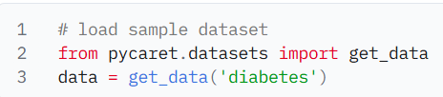
Datasets
Simple function to load datasets that can be used with the other modules

Slide 7
Live Demo
Modules
Classification
Regression
Time Series
Clustering
Anomaly Detection

Slide 8
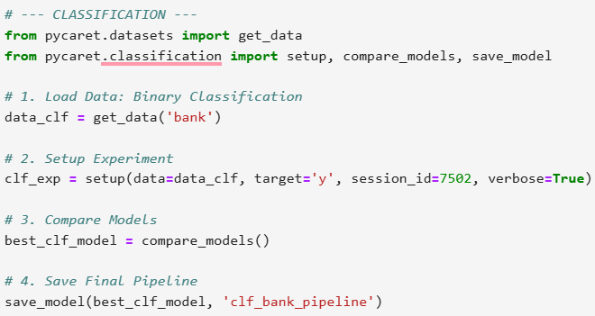
Classification
PyCaret’s Classification Module is a supervised machine learning module that is used for classifying elements into groups.
The goal is to predict the categorical class labels which are discrete and unordered. Some common use cases include predicting customer default (Yes or No), predicting customer churn (customer will leave or stay), the disease found (positive or negative).

Slide 9
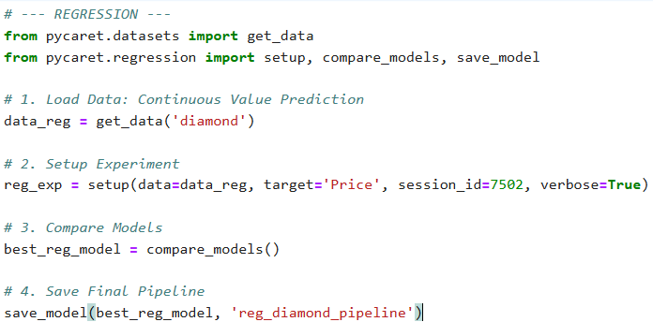
Regression
PyCaret’s Regression Module is a supervised machine learning module that is used for estimating the relationships between a dependent variable (often called the ‘outcome variable’, or ‘target’) and one or more independent variables (often called ‘features’, ‘predictors’, or ‘covariates’).
The objective of regression is to predict continuous values such as predicting sales amount, predicting quantity, predicting temperature, etc.

Slide 10
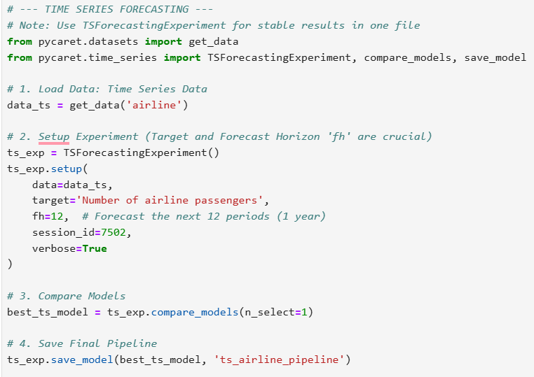
Time Series
PyCaret Time Series module is a powerful tool for analyzing and predicting time series data using machine learning and classical statistical techniques. This module enables users to easily perform complex time series forecasting tasks by automating the entire process from data preparation to model deployment.
PyCaret Time Series Forecasting module supports a wide range of forecasting methods such as ARIMA, Prophet, and LSTM. It also provides various features to handle missing values, time series decomposition, and data visualizations.

Slide 11
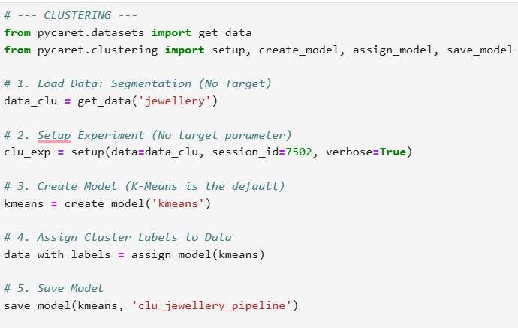
Clustering
PyCaret’s Clustering Module is an unsupervised machine learning module that performs the task of grouping a set of objects in such a way that objects in the same group (also known as a cluster) are more similar to each other than to those in other groups.

Slide 12
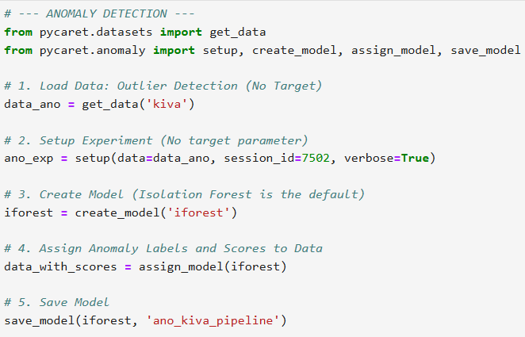
Anomaly Detection
PyCaret’s Anomaly Detection Module is an unsupervised machine learning module that is used for identifying rare items, events, or observations that raise suspicions by differing significantly from the majority of the data.
Typically, the anomalous items will translate to some kind of problems such as bank fraud, a structural defect, medical problems, or errors.

Slide 13
Summary
Speed, Depth, and Consistency
PyCaret streamlines the ML lifecycle, making advanced techniques accessible and consistent.
It allows data scientists to prototype faster and move models to production quicker.

Slide 14
Thank You

